Slide 1

Centre for Project Management
Welcomes you to
Post Graduate in Advanced Project Management
Batch 33 – PG-APM

Slide 2
Video 1
2019 Award PMI Global Conference
L&T Bassein Development Project

Slide 3
Goal / Action item
Goal | Action Item
Improve employee morale | Collect data from Exit interviews Employee survey Cultural audit Interviewing “retained” employees Assessment of personality types and working styles New hire “30 –day” luncheons
Broaden staff competencies | Competencies for all positions completed and system established to maintain and ongoing competencies
Attain stronger employee commitment to organizational standards for productivity, outcomes and customer satisfaction | Six week series on management & leadership Leadership training for supervisors etc Job descriptions format redesigned around org effectiveness
Improve recruitment efforts | Increase recruitment efforts, additional advertising, three job fairs.
Goal : Reduce employee turnover from 60 percent to 40 percent
Program Manager : HR Director

Slide 4
Converting your goal into action items using mind map
Mind Mapping is an effective tool for taking information from your brain and putting it on paper for a variety of reasons or for scribing new data coming into your brain.
Brainstorming, organizing, requirements gathering, decision making, and planning are just a few of the many applications for Mind Mapping.
Accessing the creative genius of your team, encourage original thoughts and contributions from team members, and to organize your own thoughts, and those of your team, efficiently and effectively.

Slide 5
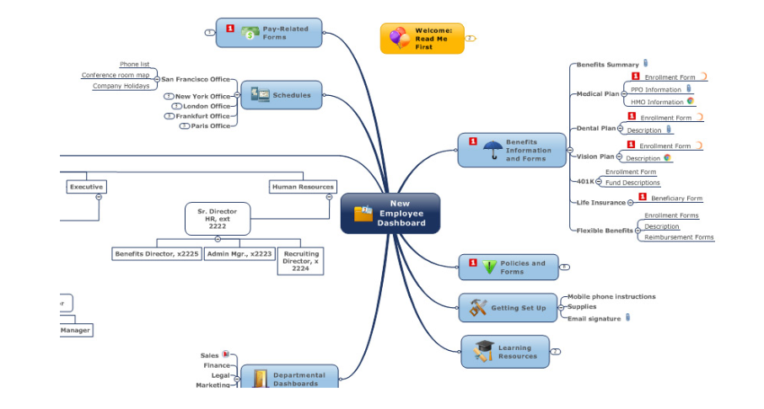
Use of Mind Map – Example 1
Source: https://www.mindjet.com/uses/information-knowledge-management/
Input to the first Initial Project Document

Slide 6
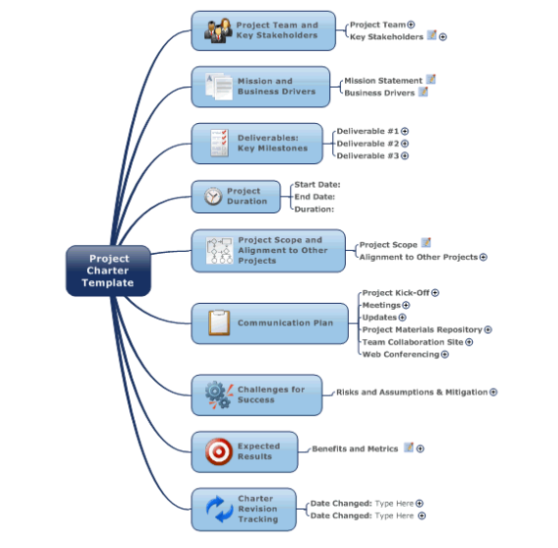
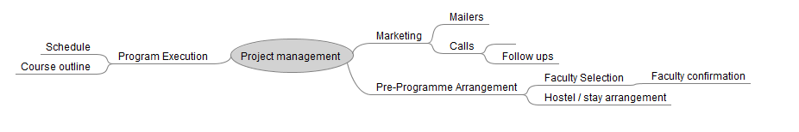
Use of Mind Map 2: Project Charter
Freemind software : https://sourceforge.net/projects/freemind/files/latest/download

Slide 7
Project Initiation
A clear justification for the project
Formal authorization to perform the work
The authority to apply organizational resources to the work

Slide 8
Key steps
Develop a Business Case
Do a feasibility study
Establish the project Charter
Identify Stakeholders
Appoint Project Team and Setup Project office
Review the Project and Gain approval for the next phase

Slide 9
Business Case
What is the business case?
What is the purpose of the business case?
Why use business case analysis?

Slide 10
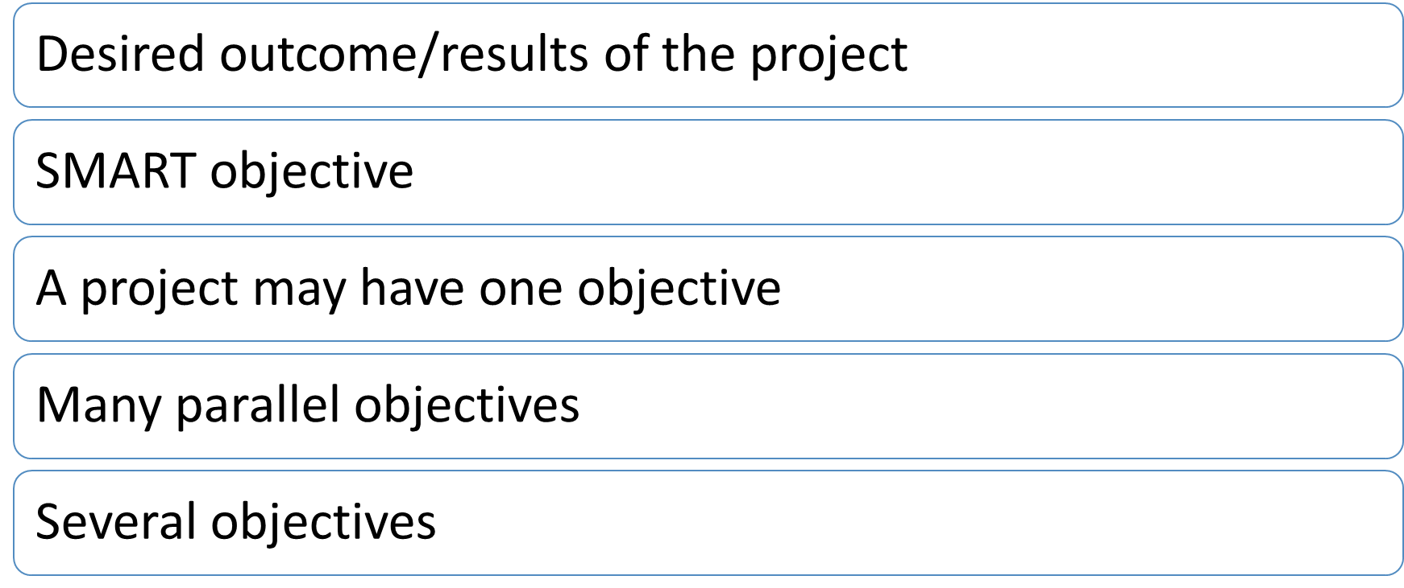
Project objective

Slide 11
Examples of Project objective
Poorly Written Objectives
  Personal: Earn more money.
  Personal: Go to university.
  Nonprofit: Help children read better.
  Business: Create a new app.
  Business: Install a new system.

Slide 12
Examples of Well Written Objectives
Personal: Your goal may be to buy a house, but your objective is to get a condominium for under $250,000 with two bedrooms by August.
Business: The goal is to build up the company in the near future. The objective is to increase sales of Super Widget by 10 percent by the second quarter of next year.
Business: The goal is to make existing customers happier. The objective is to improve customer satisfaction rates by 50 percent by June 30 through training of customer service team.
Nonprofit: The goal is to restore a native habitat around the retention pond near the Old Road to encourage native bird and animal species to visit and improve water filtration. The objective is to support residential homeowners around the pond to remove and replace non-native plants on one-third of the designated area by December.
Nonprofit: The goal is to ensure that homeless women have access to regular meals. Three objectives can help accomplish this goal:
  Objective 1: To locate a kitchen and eating space on a bus route that can serve 30 women by December 15.
  Objective 2: To recruit volunteers who will staff the kitchen for breakfast and dinner by December 30.
  Objective 3: To organize a regular donated food supply for breakfasts and dinners from local organizations and restaurants by December 30.

Slide 13
What are the Benefits of writing a good project objective?
Affects every step in a project life – cycle
Team understands what they are working towards

Slide 14
Stakeholder Analysis and Communication Planning
Core Objective | Behavioural Objective
Enumerate, describe and prioritize each set of stakeholders for the project | How to build project relationship and why they are important for communications
List each section of communication plan and describe the role each plays | Develop a project communications management plan for a real project
Build a communication matrix for a real project | Plan, Conduct and improve project meetings
Develop strategies for stakeholder management

Slide 15
Identify Stakeholder
Find Stakeholders
  Who will be affected by the project,
  Who will impact the project
  It includes people who:
    Work on the project
    Provide people, resources for the project
    Have their routines disrupted by the project
    Monitor regulations, laws and standards of practice at local, country, state or federal levels.

Slide 16
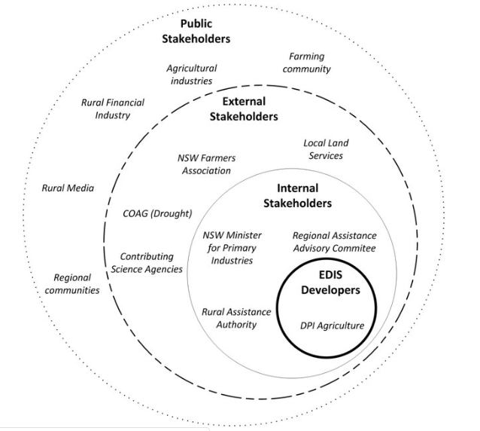
How to identify stakeholder for success
(Stakeholder map)
A generalized stakeholder map for the Enhanced Drought Information System.
Clark, Anthony & Mcgowen, I & Crean, J & Kelly, R & Wang, Bin. (2016). STAGE 1 | ENHANCED DROUGHT INFORMATION SYSTEM NSW DPI Combined Drought Indicator.
https://www.smartsheet.com/what-stakeholder-analysis-and-mapping-and-how-do-you-do-it-effectively

Slide 17
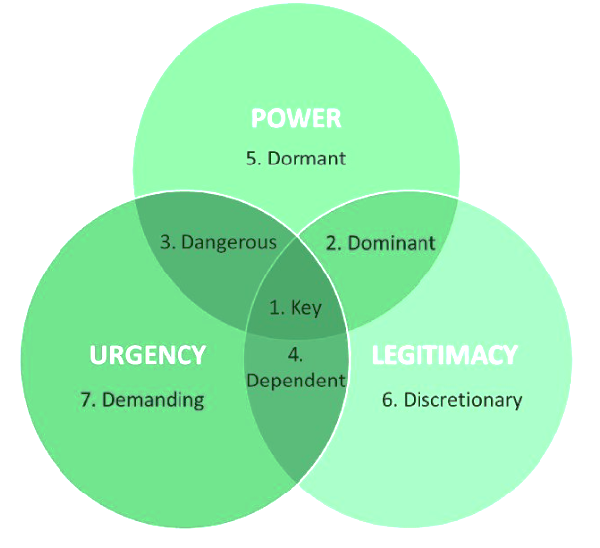
Generic stakeholder map with three attributes
SALIENCE Model
Kunz, Nathan & Atasu, Atalay & Mayers, Kieren & Van Wassenhove, Luk. (2014). Extended Producer Responsibility: Stakeholder Concerns and Future Developments. White paper by the INSEAD Social Innovation Center.

Slide 18
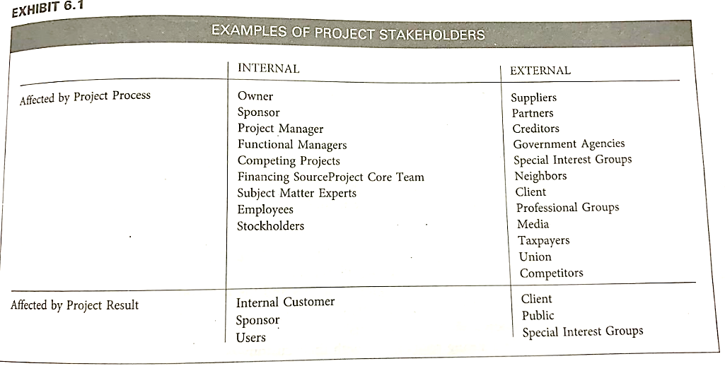
Kloppenborg, T. (2014). Contemporary project management. Nelson Education.

Slide 19
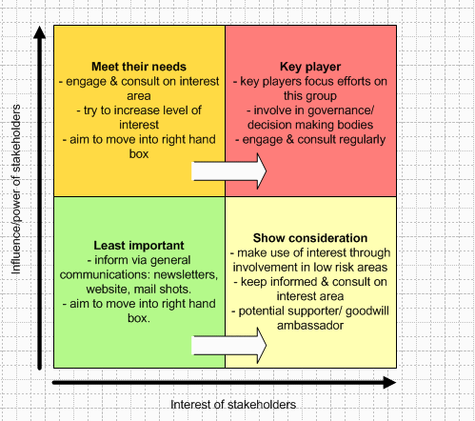
Analyze Stakeholders
Questions for assessing stakeholder importance/legitimacy
How much influence does the stakeholder have?
Is the stakeholder more or less influential in certain areas/capacities?
Do they have legal rights?
How could they hinder us?
Have we come across the stakeholder before? What was their involvement/status?
What responsibilities do we have to this stakeholder?
What are the stakeholders' stakes?
A common approach is to map the interest and power or influence of each stakeholder group on a quadrant (Bryson 1995: 71 -5).
https://www.stakeholdermap.com/stakeholder-analysis.html

Slide 20
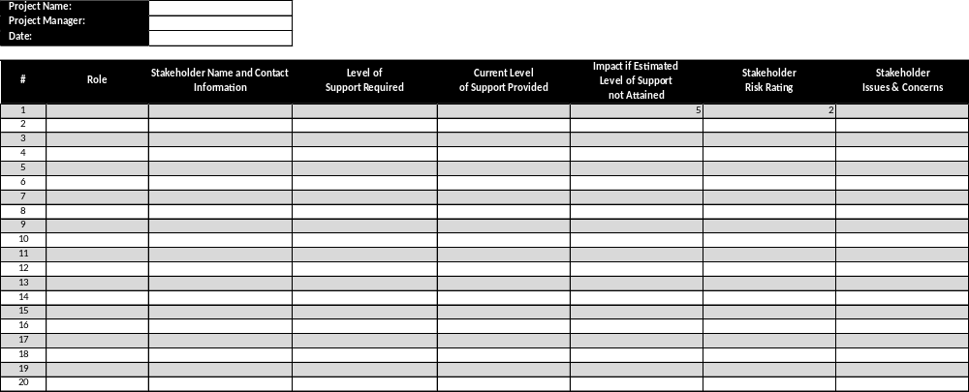
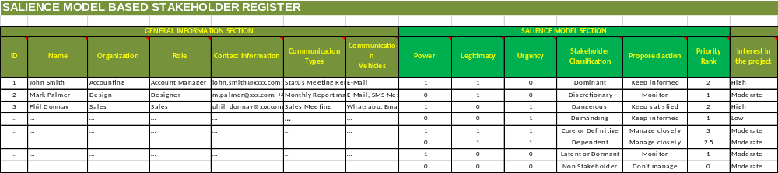
Stakeholder Register

Slide 21
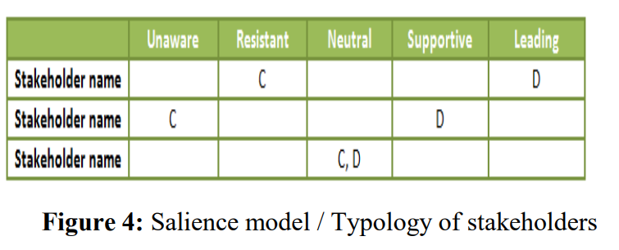
Stakeholder Engagement Assessment Matrix
Riahi, Youssra. (2017). Project stakeholders:Analysis and Management Processes. International Journal of Economics and Management Studies. 4. 39-45. 10.14445/23939125/IJEMS-V4I3P108.

Slide 22
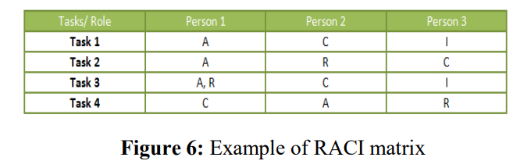
RACI Matrix
Riahi, Youssra. (2017). Project stakeholders:Analysis and Management Processes. International Journal of Economics and Management Studies. 4. 39-45. 10.14445/23939125/IJEMS-V4I3P108.

Slide 23
Case Study

Slide 24
Project Charter
What is it called?
  Initial project document (IPD)
  Statement of Work (SOW)
  Contractual level agreements or Service level agreement
What is it?
  Project charter is a document / email which can be used formally or informally to include business need for a project and how the project will meet the need.
What are its elements?

Slide 25
Elements of Project Charter
Project purpose or justification
Measurable project objectives and related success criteria
High-level requirements
Assumptions and constraints
Exclusions or Boundaries
High-level risks
Summary milestone schedule
Summary budget
Stakeholder list
Project approval requirements (i.e. what constitutes project success, who decides the project is successful, and who signs off on the project
Assigned project manager, responsibility, and authority level, and
Name and authority of the sponsor or other person(s) authorizing the project charter

Slide 26
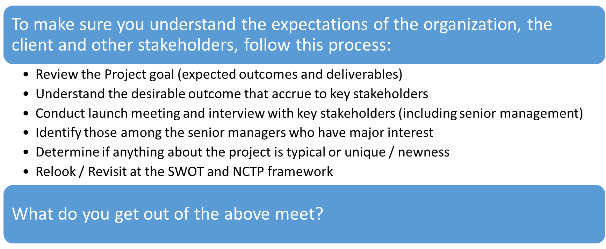
The Planning Process – Nuts and Bolts

